Slide 1
LECTURE-3
(Structures,Unions, Enumerations )

Slide 2
Structure
Group of data items of different data types held together in a single unit.

Slide 3
Declaring a Structure
struct sname
{
type var1;
type var2;
type var3;
.
.
type varN;
};
struct is a keyword to define a structure.
sname is the name given to the structure data type.
type is a built-in data type.
var1,var2,var3,…..,varN are elements of structure being defined.
Structure template
sname is called tag makes it possible to declare other variable of the same structure type without having to rewrite the template itself. It’s a type name.tag is optional.

Slide 4
Eg to store information of an employee, our structure declaration may look like as shown overleaf
struct employee_type
{
int code;
char name[20];
int dept_code;
float salary;
};
No variable has been associated with this structure
No memory is set aside for this structure.

Slide 5
Declaring Variables of the Structure Type
Declares a variable employee of type employee_type
At this point, the memory is set aside for the structure variable employee.
We can also declare variable(s) of structure type along with the structure declaration.
struct employee_type employee;
struct employee_type
{
int code;
char name[20];
int dept_code;
float salary;
}employee

Slide 6
Consider the declarations to understand how the elements of the structure variables are stored in memory
struct example_type
{
char var1;
int var2;
float var3;
double var4;
};
struct example_type sample1;
Note: all members are stored in contiguous memory location in order in which they are declared.

Slide 7
How the elements of the structure variables are stored in memory
1197
1198
1199
1200
1201
1202
1203
1204
1205
1206
1207
1208
1209
1210
1211
var 1
var 2
var 3
var 4

Slide 8
Intializing Structures
struct student_type
{
int rollno;
char name[25];
int age;
float height;
};
struct student_type student={1000,”Surbhi salaria”,18,5.6};

Slide 9
Accessing Structure Elements
Elements are accessed using dot operator.
It provides a powerful and clear way to refer to an individual element.
Syntax: sname.vname
sname is structure variable name.
vname is name of the element of the structure.
Eg: the element of the structure variable student can be accessed as
student.rollno,student.name,student.age,student.height

Slide 10
Entering Data into Structures
Void main()
{
struct employee_type
{
int code;
char name[25];
char dept[15];
float salary;
};
struct employee_type employee;
cout<<“\nEnter employee code:\n”;
cin>>employee.code;
cout<<“\nEnter name:\n”;
gets(employee.name);
cout<<“\nEnter employee’s dept:\n”;
gets(employee.dept);
cout<< “\nEnter employee’s salary:\n”;
cin>>employee.salary;
continue
continue
cout<<“\n\nParticulars of emp as entered by user\n”;
cout<<“\nEmployees code:”<<employee.code;
cout<<“\nEmployee’s name:”<<employee.name;
cout<<“\nEmployee’s dept:”<<employee.dept;
cout<<“\nEmployee’s sal:”<<employee.salary;

Slide 11
Use of Assignment Statement for Structures
Value of one structure variable can be assigned to another variable of the same type using simple assignment statement.if student1 and student2 are structure variable of type student_type,then
student2=student1;
Assigns value of structure variable student1 to student2

Slide 12
WAP to copy structure elements from one object to another object
#include<iostream.h>
#include<conio.h>
#include<string.h>
Void main()
{
Struct disk
{
Char name[15];
Float type;
Int price;
};
clrscr();

Slide 13
struct disk d1={“sony”,1.44,20};
struct disk d2,d3;
strcpy(d2.name,d1.name);
d2.type=d1.type;
d2.price=d1.price;
d3=d2;
Cout<<d1.name<<d1.type<<d1.price;
Cout<<d2.name<<d2.type<<d2.price;
Cout<<d3.name<<d3.type<<d3.price;
getch();
}

Slide 14
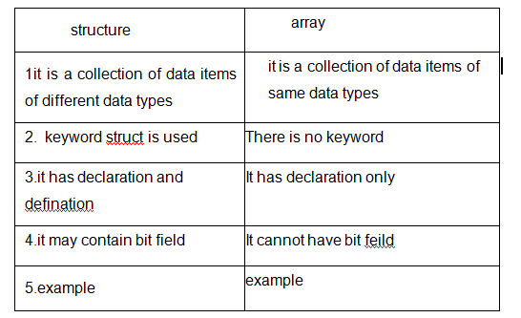
Difference b/w array and structure

Slide 15
To find avg marks of 3 subjects of 5 students
Void main()
{
Struct student
{
int subject1;
int subject2;
int subject3;
}
};

Slide 16
int i,total=0;
float av;
struct student st[20];
for(i=0;i<=5;i++)
{
cout<<“enter the marks of 3subjects of “<<i+1 <<“student”,;
cin>>st[i].subject1;
cin>>st[i].subject2;
cin>>st[i].subject3;
total= st[i].subject1+ st[i].subject2+ st[i].subject3;
av=total/3;
Cout<<“avg of marks of “<<i+1<<“student is=“<<av;
}
getch();
}

Slide 17
Array within Structure
when a array declared and processed within a structure, then it is called array within strucure
struct name
{
char fname[10];
char lname[10];
};

Slide 18
Nested Structure
Structure can be embedded within another structure,i.e when a structure declared and processed within another structure,then it is called nesting of structure

Slide 19
Syntax
Struct tag1
{
member elements-1;
…………………………………..
member element-m;
};
struct tag2
{
struct tag1 v1;
};
Struct tag2 v2;

Slide 20
Example
Void main()
{
stuct name
{
char fname[10];
char lname[10];
};
Struct bdate
{
int day;
int month;
int year;
};

Slide 21
struct data
{
struct name n;
struct bdate b;
};
struct data d;
Cout<<“enter name”;
Cin>>d.n.fname>>d.n.lname;
Cout<<“enter birth date”;
Cin>>d.b.day>>d.b.month>>d.b.year;
Cout<<“name”<< d.n.fname<<d.n.lname;
cout<<“DOB”<<d.b.day<<d.b.month<<d.b.year;
}

Slide 22
Structure and Function
The relationship of structure with the function can be viewed as:-
      Passing Structures to a function..

Slide 23
Passing Structure to a Function
Similar to passing array of variable,structure can be passed to a function as argument
Syntax:
Data-type func-name(struct-variable); /*actual argument*/

Slide 24
Read and display student grade by using structure with function
struct student
{
int rn;
char name[20];
char grade;
}s;
main()
{
cout<<“\nEnter rollno,name and grade of student:\n”;
cin>>s.rn>>s.name>>s.grade;
display(s);
getch();
}
display(struct student m)
{
cout<<“\nRollno is “<<m.rn;
cout<< “\n Name is”<<m.name;
cout<< “\n Grade is:”<<m.grade;
}

Slide 25
Passing of structure variables by value to a function
struct date
{
int day;
int month;
int year;
};
void print_date(struct date);
void main()
{
struct date d={10,12,1997};
print_date(d);
}
void print_date(struct date a)
{
cout<<“\nDate in format “<<a.day<<a.month<<a.year;
}

Slide 26
UNION
A union is variable that declares a set of multiple variable (called members or elements having different data-type)sharing the same memory area
The union require the bytes that are equal to the number of bytes required for the largest member.

Slide 27
It is declared in two ways:-
Union union-tag
{
Data-type-1 member-element-1;
--------------------------------------
Data-type-n meber-element-2;
}v1,v2,....vn;
Union union-tag
{
Data-type-1 member-element-1;
--------------------------------------
Data-type-n meber-element-2;
};
Union tag-name v1,v2,....vn;

Slide 28
Union item
{
int m;
float x;
char c;
} code;
This declare a variable code of type union item.

Slide 29
WAP to find the size of union and number of bytes reserved for it
main()
{
union result
{
int marks;
char grade;
};

Slide 30
struct res
{
char name[15];
int age;
union result r1;
}data;
Cout<<“size of union %d”,sizeof(data.r1);
Cout<<“size of structure %d”,sizeof(data);
}

Slide 31
Union
Union:
Union is similar as structure. The major distinction between them in terms of storage.
In structure each member has its own storage location whereas all the members of union uses the same location.
The union may contain many members of different data type it can handle only one member at a time union can be declared using the keyword union.

Slide 32
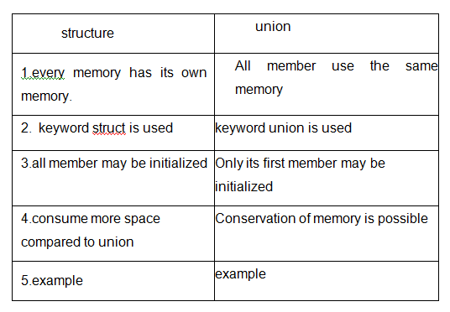

Slide 33
Enumeration (ENUM)
An enumeration is a user-defined type consisting of a set of named constants called enumerators
It serves to create data types, that is not limited to either numerical or character constants or Boolean values
The values that we specify for the data type must be legal identifiers
The syntax for declaring an enumeration type is:
enum typeName{value1, value2, ...};
The syntax to declare an enum is as follows:
  enum model_name {
  value1,
  value2,
  value3,
  . .};

Slide 34
Declaration of Enumerated Types
Consider the colors of the rainbow as an enumerated type:
enum rainbowColors
{ red, orange, yellow, green,
blue, indigo, violate };
The identifiers between { } are called enumerators
The order of the declaration is significant
red < orange < yellow …

Slide 35
Enumeration (ENUM) (Contd..)
By default, the first enumerator has a value of 0
Each successive enumerator is one larger than the value of the previous one, unless you explicitly specify a value for a particular enumerator

Slide 36
Declaration of Enumerated Types
Why are the following illegal declarations?
enum grades{'A', 'B', 'C', 'D', 'F'};
enum places{1st, 2nd, 3rd, 4th};
They do not have legal identifiers in the list
What could you do to make them legal?
enum grades{A, B, C, D, F};
enum places{first, second, third, fourth};

Slide 37
Declaration of Enumerated Types
As with the declaration of any object
  Specify the type name
  Followed by the objects of that type
Given:
enum daysOfWeek { Sun, Mon,
Tue,Wed, Thu, Fri, Sat }
Then we declare:
daysOfWeek Today, payDay, dayOff;

Slide 38
Assignment with Enumerated Types
Once an enumerated variable has been declared
  It may be assigned an enumerated value
  Assignment statement works as expected
payDay = Fri; // note no quotes
// Fri is a value, a constant
Enumerated variables may receive only values of that enumerated type

Slide 39
Operations on Enumerated Type Objects
Incrementing variables of an enumerated type
Do NOT use workaday += 1;
NOR today++;
Instead, use explicit type conversion
today = daysOfWeek (today + 1);

Slide 40
Example
void main()
{
enum days{sun,mon,tues,wed,thur,fri,sat};
days day1,day2;
day1=sun;
day2=fri;
cout<<day1<<“\t”<<day2;
if(day1>day2)
{
cout<<“day1 comes after day2”;
}
else
{
cout<<“day1 comes before day2”;
}
}

Slide 41
The typedef statement
Definition:– a typedef is a way of renaming a type
Syntax:
typedef existing_type_name new_type_name;
Example:
typedef int Boolean;
Does not really create a new type
  is a valuable tool for writing self-documenting programs

Slide 42
#include<iostream.h>
#include<conio.h>
int main()
{
typedef int ME;
ME a=1, b;
cin>>b;
cout<<"the nos are \n"<<a<<"\n"<<b;
cout<<"\n"<<sizeof(ME);
getch();
return 0;
}

